Slide 1
Design and implement a 1x8 silicon photonic power divider using multiple 1x2 multi-mode interferometers (pdk.MMI1x2Optimized1550())
By: Nittala Satya Surya Lakshmi Vasuki Siva Srinivas
#Student ID: 620094
E-mail : sn620094@wne.edu

Slide 2
Design of1x8 silicon photonic power divider in IPKISS Canvas 3.10.1 .
Code Template for Power Divider 1x8 in IPKISS canvas 3.10.1 .
1x8 silicon photonic power divider in PYCHARM
Scattering parameter simulation results in PYCHARM.
- 1x8 silicon photonic power divider using multiple 1x2 multi-mode interferometers.
- Simulation results of 1x8 silicon photonic power divider.
Power_Divider1x8.gds[Power Divider 1x8] K7layout – [1/0]
Power_Divider1x8.gds[Power Divider 1x8] K7layout – [50/2]

Slide 3
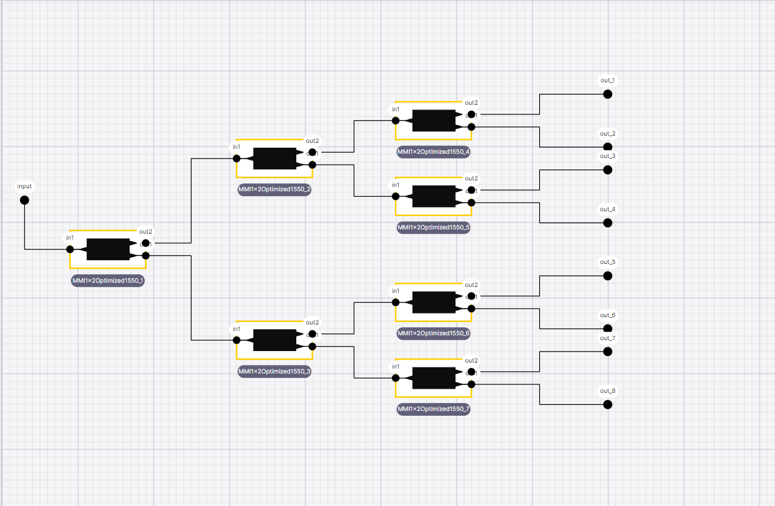
Design of1x8 silicon photonic power divider in IPKISS Canvas 3.10.1

Slide 4
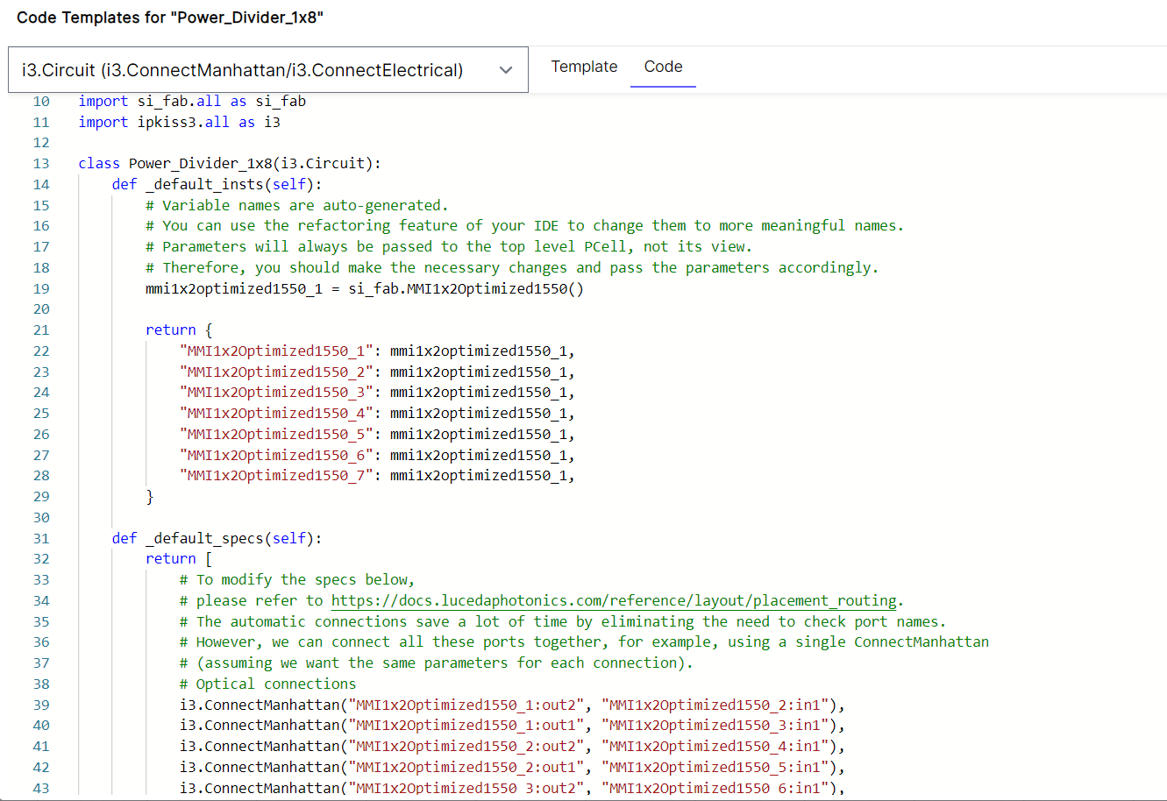
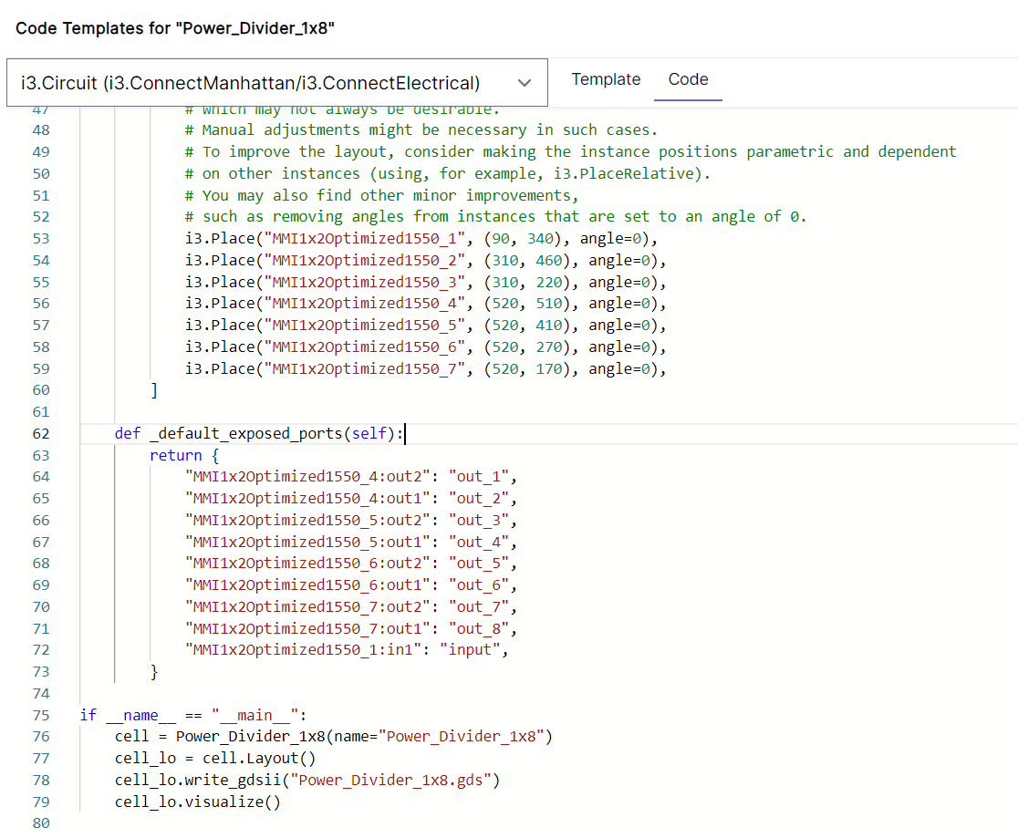
Code Template for Power Divider 1x8 in IPKISS canvas 3.10.1

Slide 5
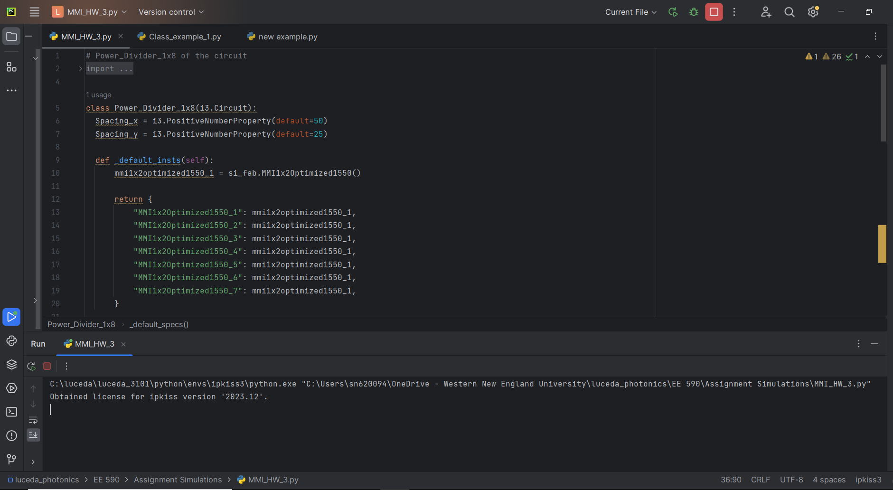
1x8 silicon photonic power divider in PYCHARM

Slide 6
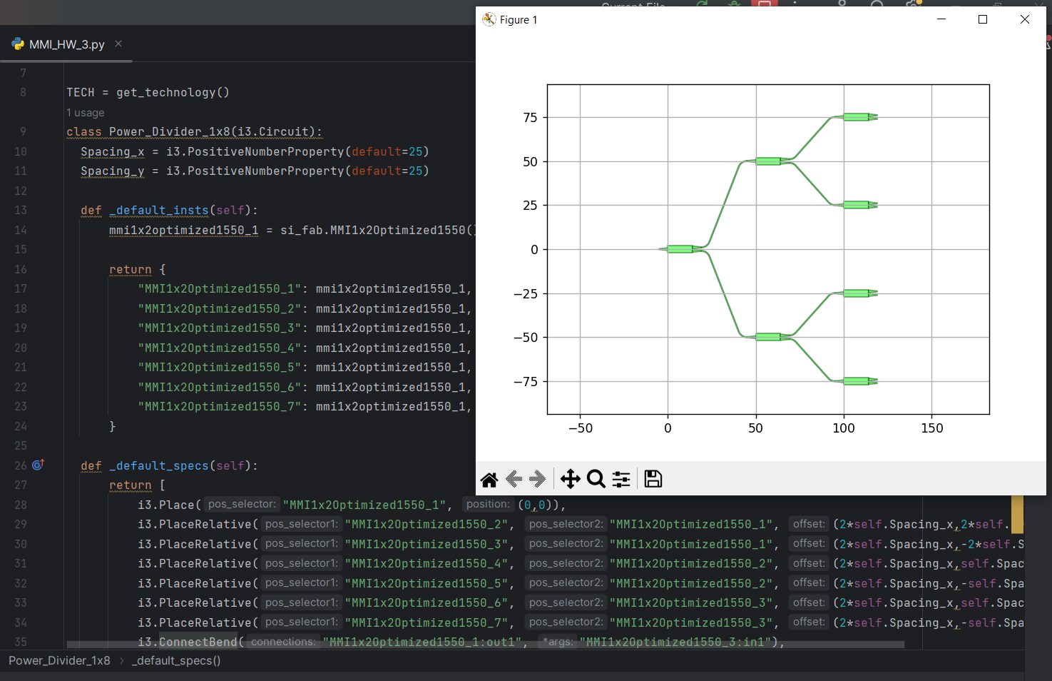
Scattering parameter simulation results in PYCHARM

Slide 7
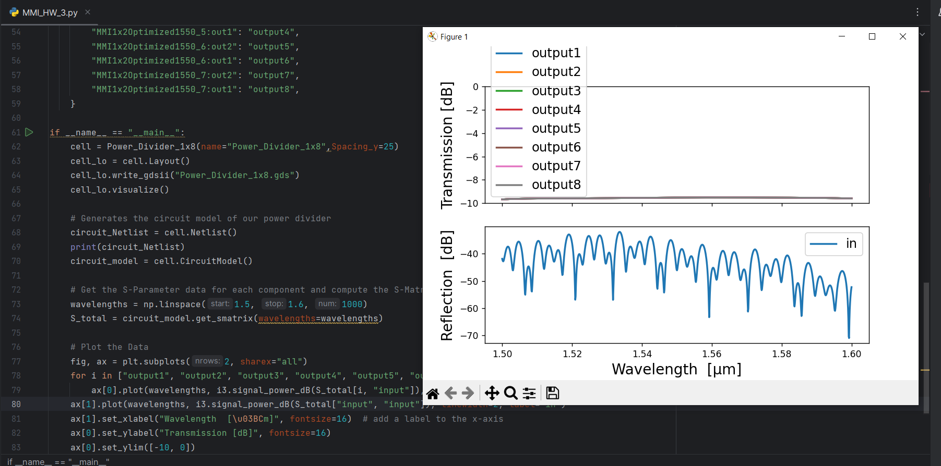

Slide 8
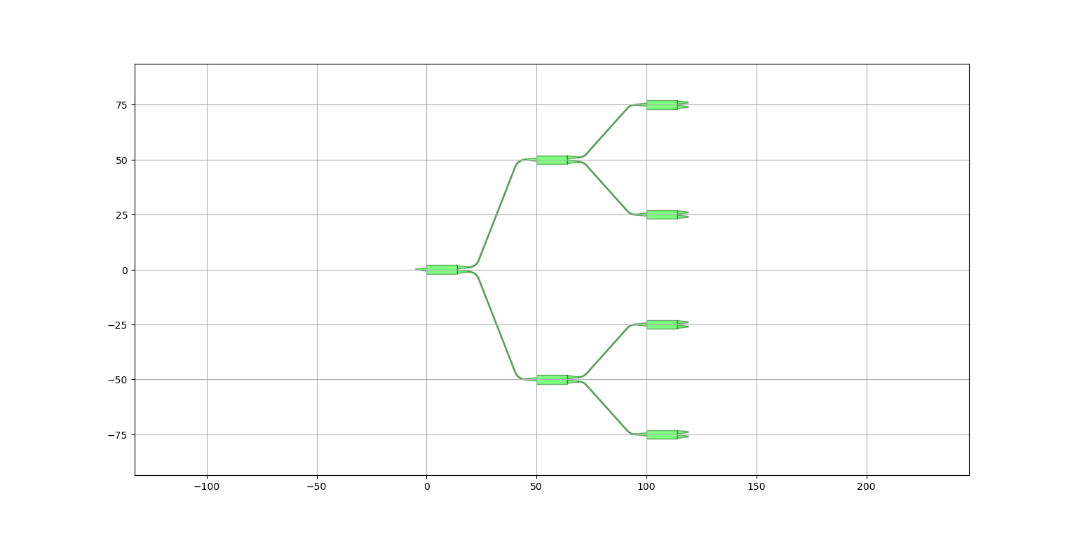
1x8 silicon photonic power divider using multiple 1x2 multi-mode interferometers

Slide 9
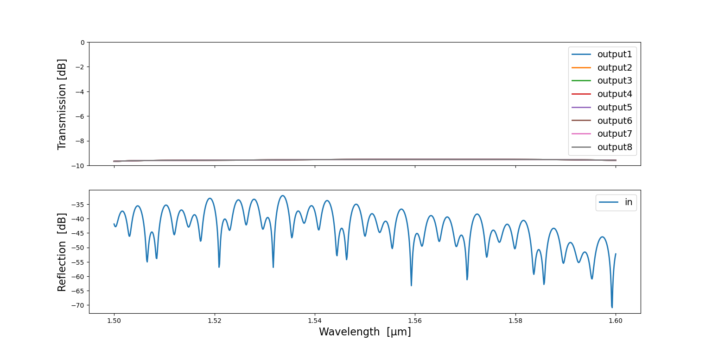
Simulation results of 1x8 silicon photonic power divider.

Slide 10
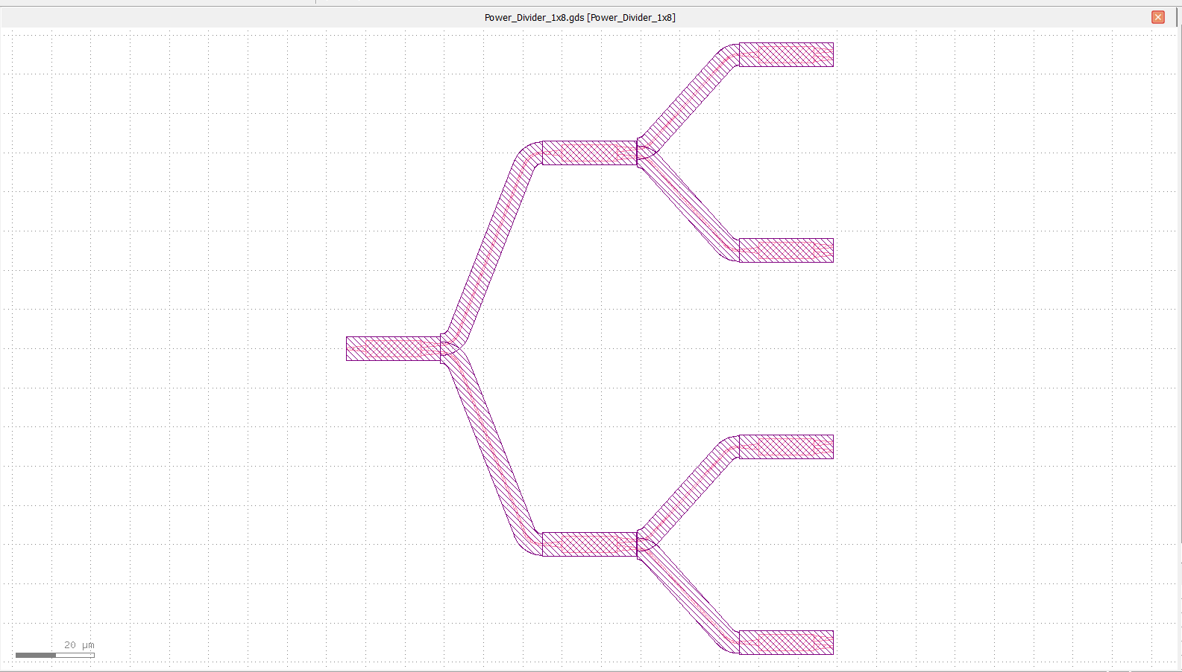
Power_Divider1x8.gds[Power Divider 1x8] K7layout – [1/0]

Slide 11
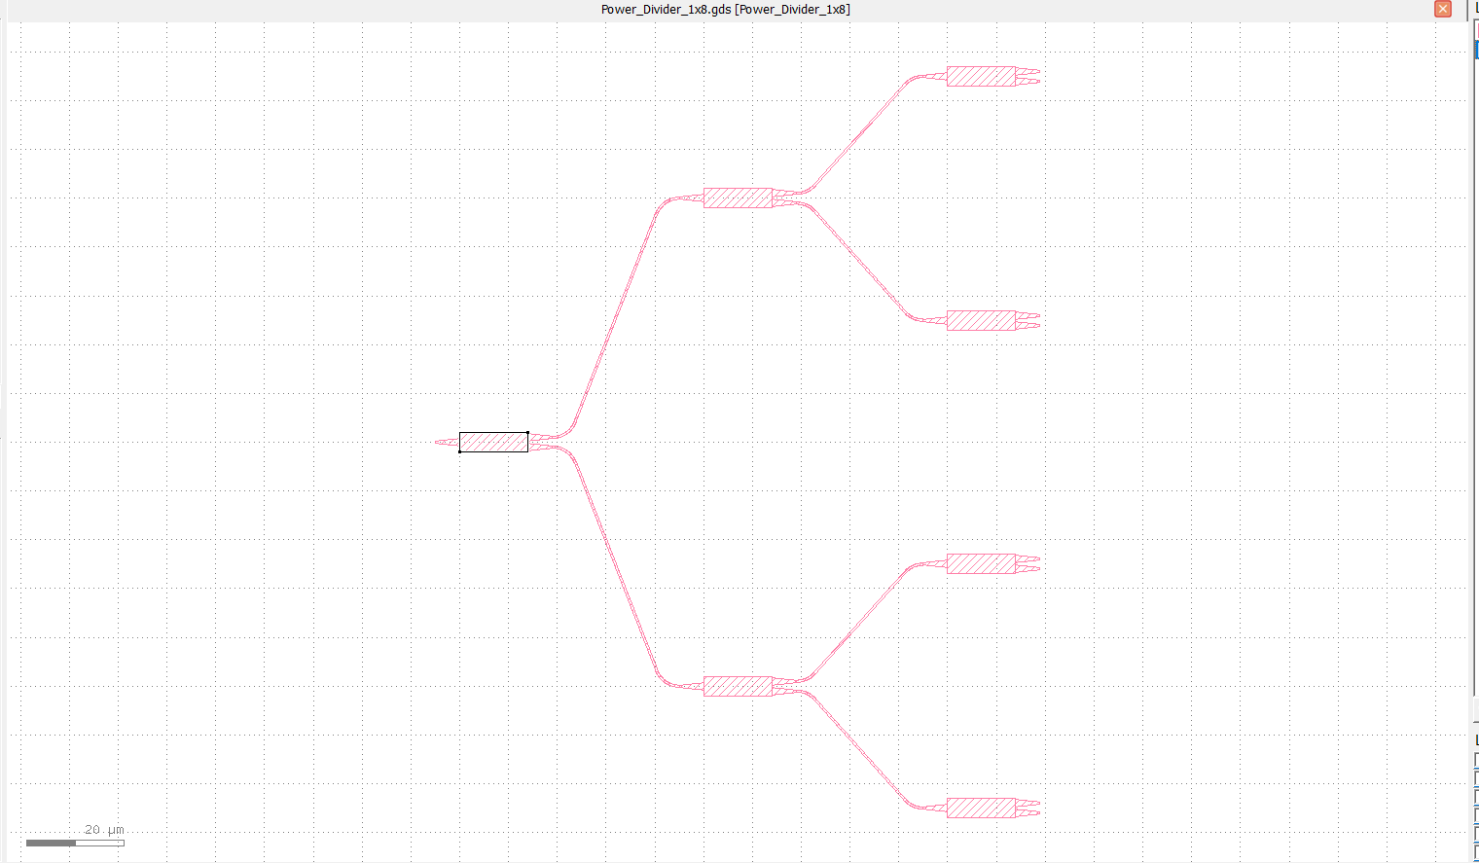
Power_Divider1x8.gds[Power Divider 1x8] K7layout – [50/2]

Slide 12
The End

